Slide 1
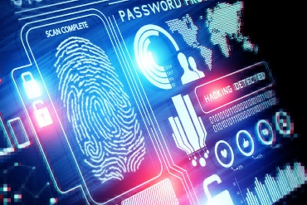
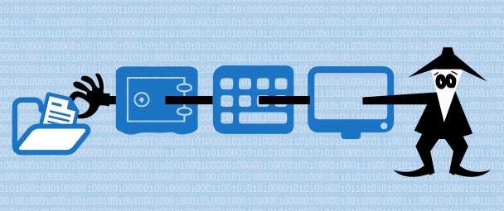
From Trust to Zero-Trust: Rethinking Privacy and Security in the Cloud Era
Andrei Tchernykh
CICESE Research Center, Ensenada, Baja California, México
chernykh@cicese.mx
http://usuario.cicese.mx/~chernykh/
Head of “Parallel and Cloud Computing Laboratory” at CICESE, Mexico
Adjunct Chief Scientist (habilitation) of the Institute for System Programming of the Russian Academy of Sciences, Moscow, Russia
Head of “Laboratory of Problem-Oriented Cloud Computing” at South Ural State University. Chelyabinsk, Russia.
CIBERTIC 2025
Congreso Internacional de Ciberseguridad, Tecnologías, Innovación y Ciencia
Guadalajara, Jalisco, México, May 20-22, 2025

Slide 2
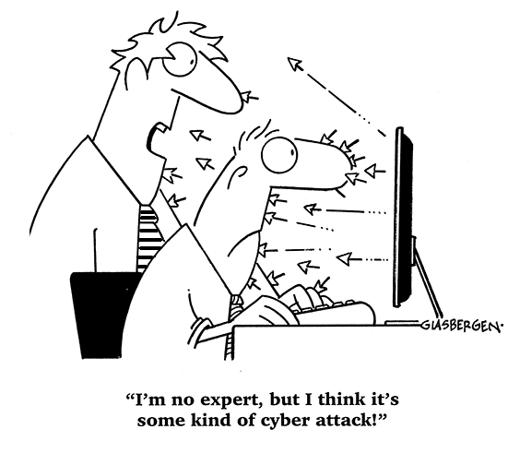
Data Security Requirements (CIA triad)
1
Confidentiality
Protecting from disclosure
2
Integrity
Modification or deletion
3
Availability
Users can access information
4
Privacy
free from public attention, not observed or disturbed
5
Scalability
ability to be used in a range of capabilities

Slide 3
Data Security Requirements (CIA triad)
Solutions
1
Symmetric encryption: AES, DES, 3DES
1
Confidentiality
Protecting from disclosure
2
Asymmetric encryption RSA, ECDSA, DSA….
2
Integrity
Modification or deletion
3
Digital signature
3
Availability
Users can access information
4
Access control
5
5
5
4
Privacy
free from public attention, not observed or disturbed
5
Data masking
5
5
5
5
Scalability
ability to be used in a range of capabilities

Slide 4
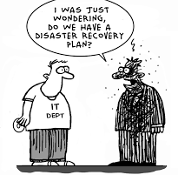
Resiliency threads
1
Environmental threats
  Earthquakes, floods, fire, etc.
2
Deliberate threats
  Interception, hacker attacks, etc.
3
Accidental threats
  PC errors, Virus, Spam, etc.
4
Unfairness
  User errors, carelessness, curiosity, falsification, etc.

Slide 5
Resiliency threads
Solutions
1
Environmental threats
  Earthquakes, floods, fire, etc
1
Replication
2
Deliberate threats
  Interception, hacker attacks, etc
2
Erasure codes
3
Accidental threats
  PC errors, Virus, Spam, etc.
3
Error detection-correction
4
Unfairness
  User errors, carelessness, curiosity, falsification, etc.
4
Checkpointing

Slide 6
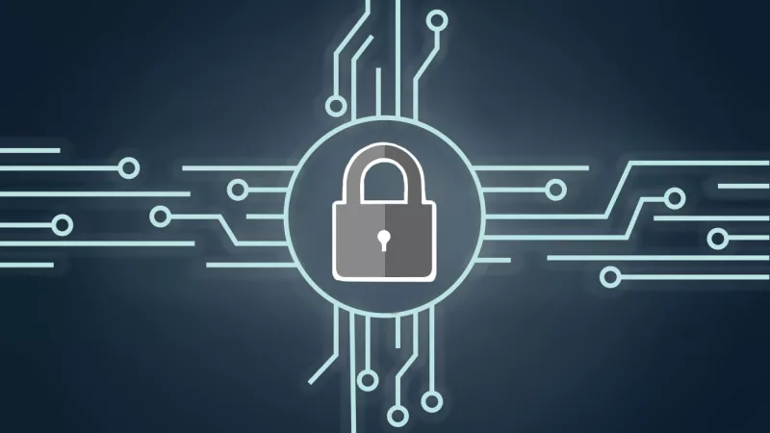

Security and Resiliency
Data security
Data Resilience
Protecting data from
Unauthorized access
Data modification
Corruption
Loss
Cyberattack or data breach
Destructive force
Ability
Protect
Maintain
Recover after
  equipment failure
  power outage
  disruption in
    servers,
    networks,
    storages,
    data centers

Slide 7




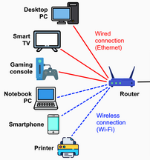
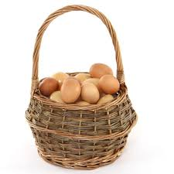
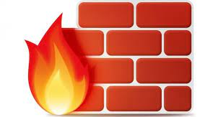


Data Storage

Slide 8
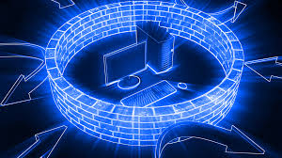
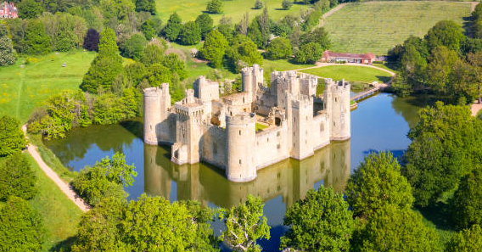
Trust Model (Perimeter-Based Security)
Trust-based models assume
Everything inside the perimeter is safe
Threats only come from outside the firewall
Users and devices inside the perimeter are implicitly trusted
Security is enforced at the entry point (e.g., firewalls, VPNs)
“Castle and moat" approach
Limitations:
Cannot protect from insider threats or compromised devices.
Lateral movement within the perimeter is often unmonitored.
Does not protect against
  remote working
  mobile devices
  cloud services

Slide 9
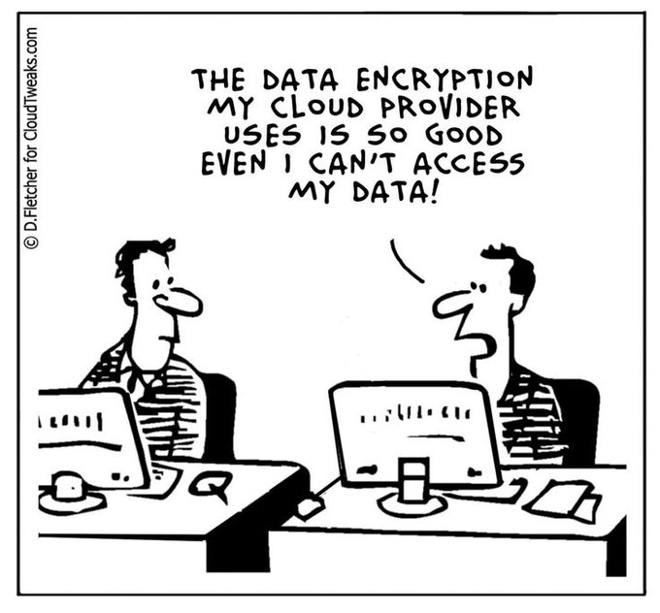
In “Trust” we have to trust
Computers under firewall
Users
Administrators
Programmers
Technicians
Encryption methods
Storages
Backups mechanisms
Disk-based hardware
Transmission security and reliability
  etc.

Slide 10
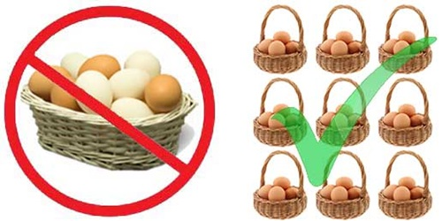
Data Storage

Slide 11
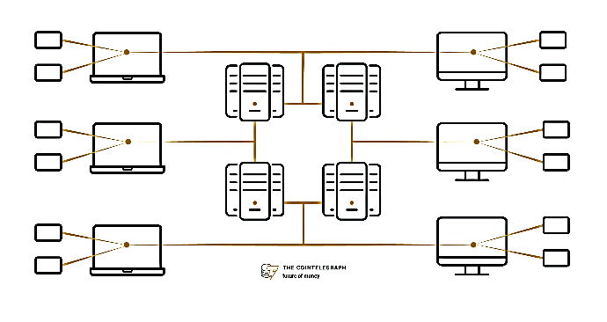
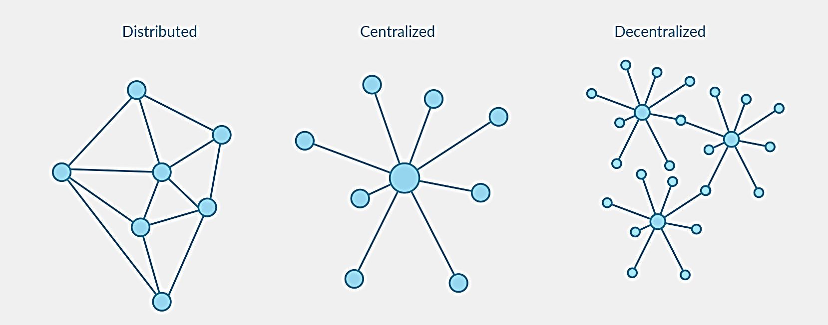
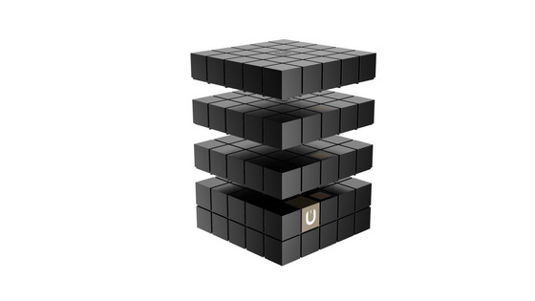
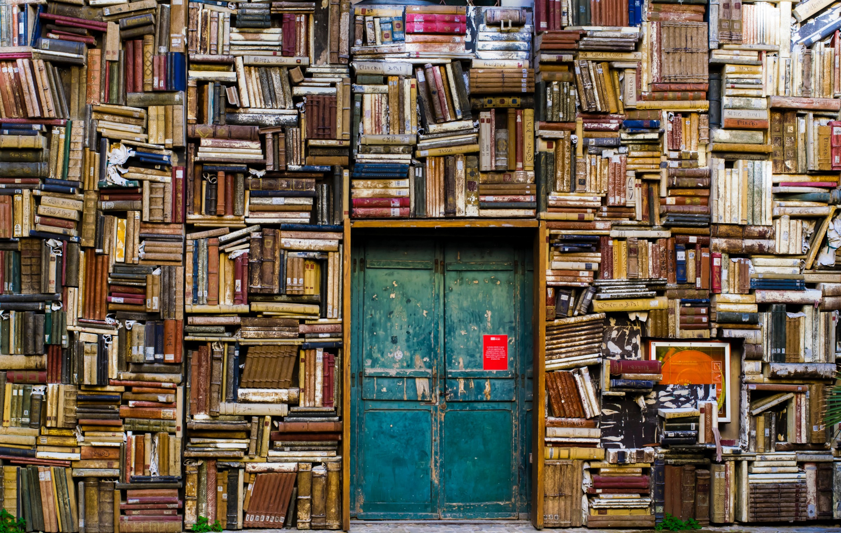
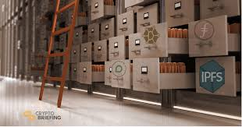
Distributed data storage

Slide 12
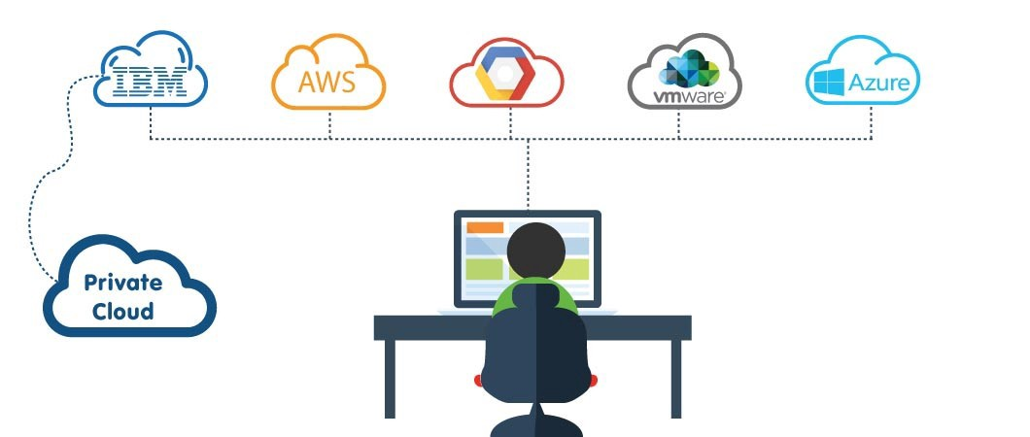
Multi-cloud distributed data storage
  Multiple cloud computing and storage services
  =
  Single heterogeneous architecture

Slide 13
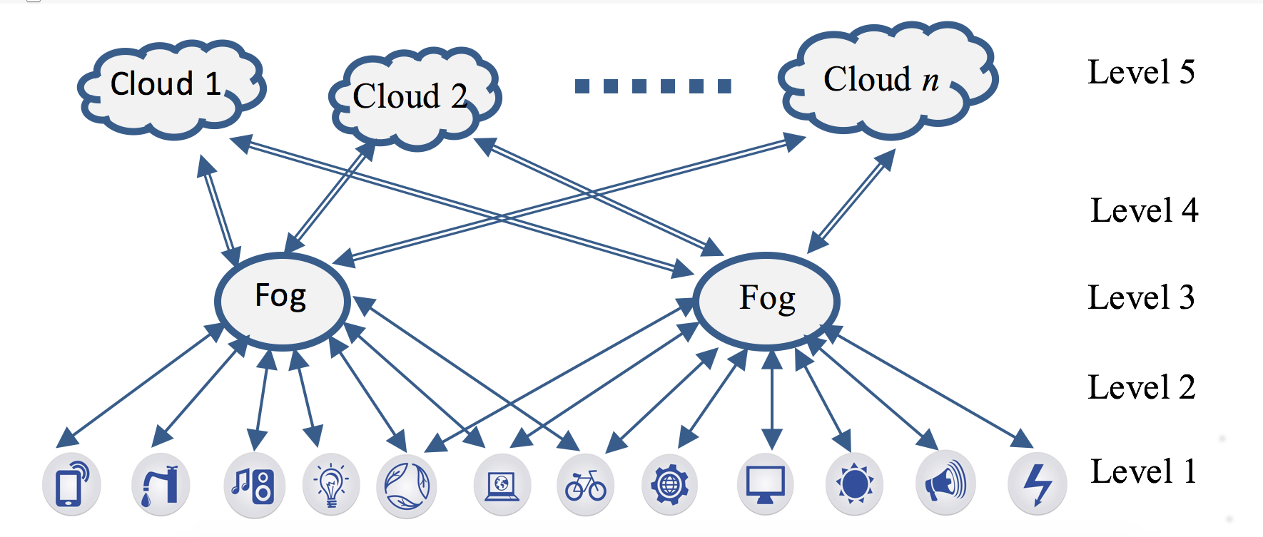
Internet of Things with Multi-cloud
Cloud computing
Storage-processing
Communication
Fog computing
Processing
Communication
Intelligent sensors
Edge computing

Slide 14

Security collusion
Improper secret agreement between two or more malicious entities, to obtain unauthorized access to confidential data
Collaborate to
decrypt sensitive data
compromise security mechanisms
Result
Account hijacking
Data loss
Abuse and illegal use of cloud services
Denial Of Service
Traditional solutions:
  Secret sharing scheme
  Asymmetric and Symmetric cryptosystems
  Access structure
14

Slide 15
Zero-Trust Model: “Never trust, always verify”:
No trust any user, device, or system—inside or outside the network.
Every access must be continuously verified.
Security is enforced at every layer: user, device, app, and data.
Core Principles of Zero-Trust:
Least privilege access: Users get only the minimum access necessary.
Micro-segmentation: Network is divided into small zones.
Strong identity verification: Multi-factor authentication (MFA), biometrics, etc.
Real-time monitoring and analytics: Constant assessment of trustworthiness.
Benefits of Zero-Trust:
Reduces risk from insider threats and compromised credentials.
Better suited for cloud, BYOD “Bring Your Own Device”, and hybrid environments.
Enhances visibility, control, and compliance.
Challenges in Implementation:
Requires new policies.
Needs investment in identity management, monitoring tools, and network segmentation.
Integration with existing systems can be complex.

Slide 16




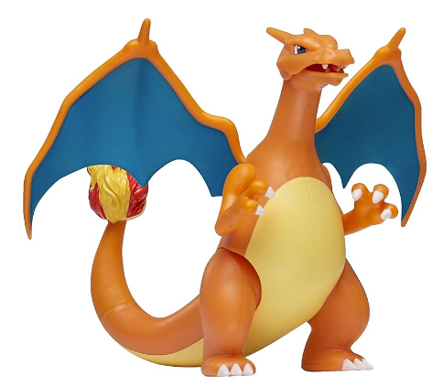


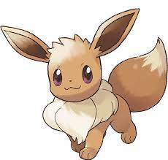
Privacy Preserving with Zero Trust

Slide 17
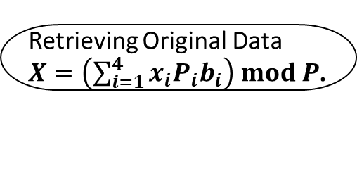
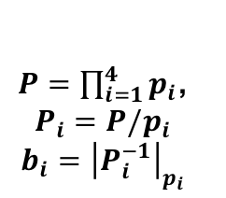
RRNS Multi-Cloud Storage
X
p₁,p₂,…,p₆
Conversion
to Residues
6 moduli
X mod p₁
X mod p₂
X mod p₃
X mod p₄
X mod p₅
X mod p₆
x₁
x₂
x₃
x₄
x₅
x₆
Retrieving Original Data
$X=\left(\sum_{i=1}^{4}{x_{i}P_{i}b_{i}}\right) mod P$.
$P=\prod_{i=1}^{4}{p_{i}}$,
$$P_{i}=P/p_{i}$$
$$b_{i}={\left|P_{i}^{−1}\right|}_{p_{i}}$$
own encryption
full control over data storage
Notes:
Shamir interpolacion de lagrange
Blakley

Slide 18

Cloud storage as a service (StaaS)
Name | URL
Alibaba Cloud | https://www.alibabacloud.com/
Amazon Drive | https://www.amazon.com/gp/drive/about
Box | http://box.com/
certain safe | https://certainsafe.com/
Dropbox | http://dropbox.com/
Egnyte | https://egnyte.com/
Elephant drive | https://home.elephantdrive.com/
FlipDrive | https://flipdrive.com/
Google Drive | https://www.google.com/drive/
Hubspot | https://www.hubspot.com/
iCloud | https://www.icloud.com/
IDrive | https://www.idrive.com/
Jumpshare | https://jumpshare.com/
JungleDisk | https://www.jungledisk.com/
Justcloud | http://www.justcloud.com/
Name | URL
MediaFire | https://www.mediafire.com/
Mega | https://mega.nz/
one backup | https://mozy.com/
One Drive | https://onedrive.live.com/
pCloud | https://www.pcloud.com/
Rackspace | https://www.rackspace.com/cloud
Salesforce | https://www.salesforce.com/
Sharefile | https://www.sharefile.com/
spideroak | https://spideroak.com/one/
storegate | https://www.storegate.com/gl/
SugarSync | https://www2.sugarsync.com/
sync | https://www.sync.com/
Windows Azure | https://azure.microsoft.com/en-us/services/storage/
Yandex Disk | https://disk.yandex.com/

Slide 19










Data access speed
High
Intermediate
Low

Slide 20
Reliability
comparison of cloud services by providing reliable and objective performance analysis
Service Name | Region | 30 Day Availability 1 block = 1 mins | Outages | Downtime
Faction Cloud | seattle | 83.1928% | 18 | 121.01 hours
eApps Cloud | richmond | 99.8051% | 1 | 1.4 hours
UpCloud | london | 99.8123% | 1 | 1.35 hours
Linode Cloud Hosting | singapore | 99.9523% | 1 | 20.6 mins
Vultr | silicon-valley | 99.9751% | 2 | 10.77 mins
UpCloud | singapore | 99.976% | 5 | 10.37 mins
Vultr | miami | 99.9802% | 11 | 55.13 mins
Linode Cloud Hosting | london | 99.9856% | 1 | 6.23 mins
Exoscale Compute | DE-FRA-1 | 99.9883% | 1 | 5.05 mins
Cloud Central | canberra | 99.9914% | 2 | 3.73 mins
Exoscale Compute | BG-SOF-1 | 99.9918% | 1 | 3.3 mins
DigitalOcean | ny1 | 99.9938% | 2 | 2.68 mins
Vultr | dallas | 99.9951% | 1 | 2.12 mins
StratoGen VMware Cloud | denver | 99.9976% | 1 | 1.02 mins
IBM Cloud Compute | MEL | 99.9984% | 1 | 41 secs
StratoGen VMware Cloud | docklands | 99.9985% | 1 | 39 secs
Alibaba Elastic Compute Service | ap-northeast-1 | 100% | 0 | None
https://cloudharmony.com/status

Slide 21











Adaptive Multi-Cloud Storage
0.00109019
0.00021404
0.00109874
2.98
3.06
0.65
1.70
2.30
0.00092609
0.75
0.00269549
2.55
0.73
2.62
0.71
0.00099030
1.46
2.93
0.00145548
2.18
3.25
(3,5)−RRNS settings
⚫ noAccess probability
⚫ Upload speed (MB/s)
⚫ Download speed(MB/s)
Secret Sharing Scheme

Slide 22







Adaptive Multi-Cloud Storage
0.00109019
0.00021404
0.00109874
0.00092609
0.00269549
2.98
3.06
0.65
1.70
0.75
2.30
2.55
0.73
2.62
0.00099030
0.71
0.00145548
1.46
2.93
2.18
3.25
⚫ noAccess probability
⚫ Upload speed (MB/s)
⚫ Download speed(MB/s)

Slide 23
Adaptive Multi-Cloud Storage
0.00109019
0.00021404
0.00109874
2.98
3.06
0.65
1.70
2.30
0.00092609
0.75
0.00269549
2.55
0.73
2.62
0.71
0.00099030
1.46
2.93
0.00145548
2.18
3.25
(3,5)−RRNS settings
Secret Sharing Scheme

Slide 24
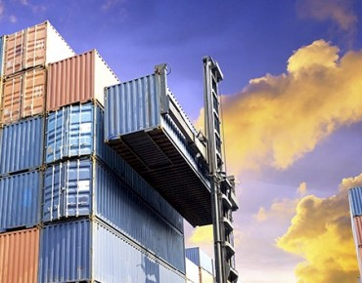
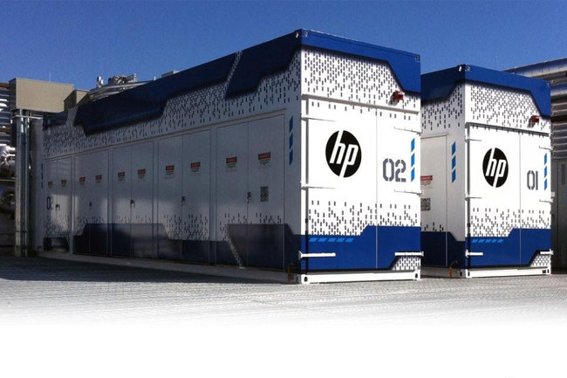

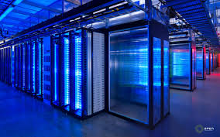
Zero Trust uncertainty in clouds
Shared resources
Hybrid infrastructure
Illusion of infinite computing resources on demand
Scalability and flexibility (dynamic elasticity)
Massive, diverse, incomplete, heterogeneous data
Virtualization, loosely coupling applications to the infrastructure
Resource provisioning time variation
Variation in data transmission
Workload uncertainty

Slide 25
Optimization problem
How to select parameters of the storage?
How many storages should be used?
How to select clouds from available?

Slide 26



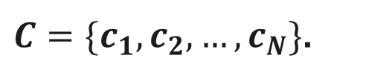
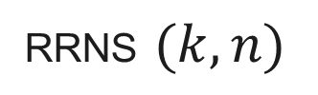
Dynamic Cloud Selection
RRNS $(k, n)$
$C=\{c_{1}, c_{2},…,c_{N}\}$.
$$P_{r}\left(k,n\right)$$
$$\{c_{i1}, c_{i2},…,c_{in}\}$$
$c_{j}=\{{err}_{j} \}$
selected storages
Estimate and classify reliability levels
Find adequate settings.
Dynamically adapt settings for security concerns

Slide 27



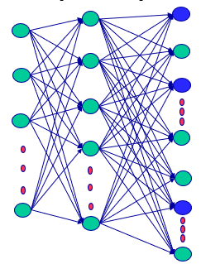
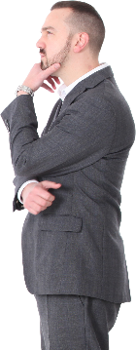
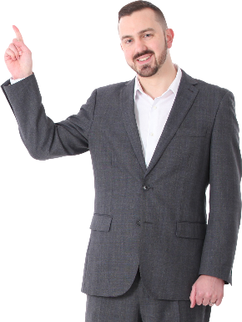
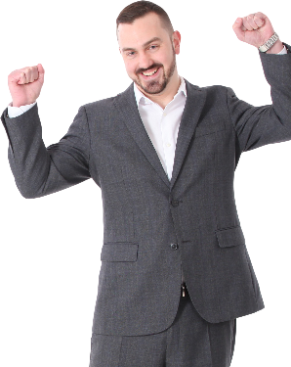

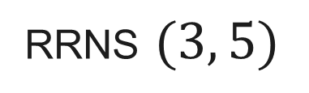

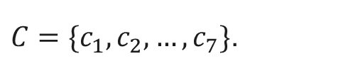
Dynamic Cloud Selection
$C=\{c_{1}, c_{2},…,c_{7}\}$.
$c_{j}=\{{err}_{j} \}$
RRNS $(3, 5)$
NN for adaptive security
selected storages
$$\{c_{i1}, c_{i3},…,c_{i5}\}$$
K = 3
Google drive parameters

Slide 28
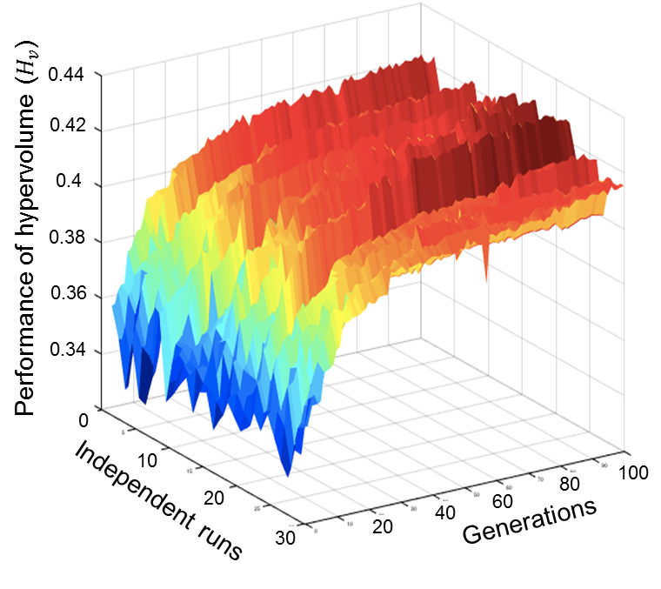
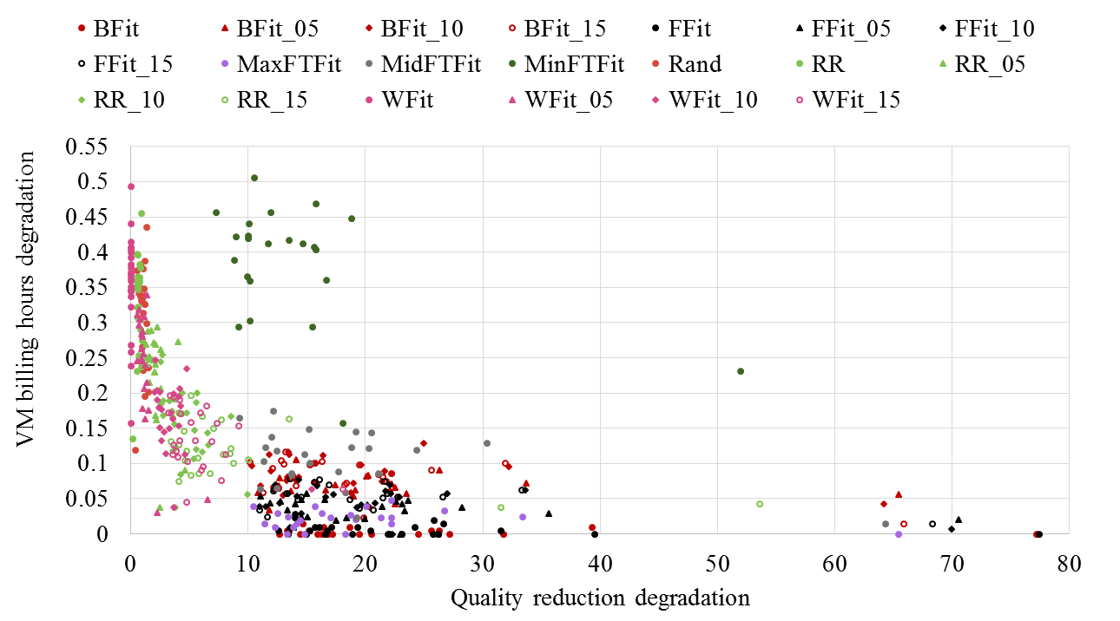
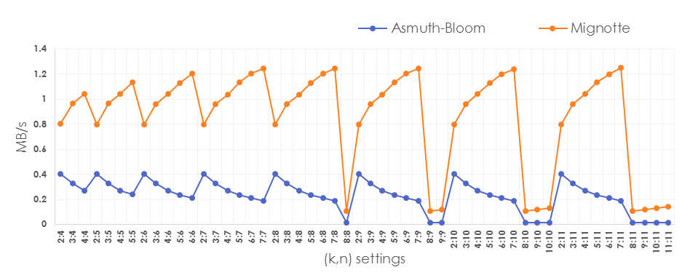
Experimental Analysis
Encoding/Decoding speeds
Upload speed
Download speed
Redundancy
Error detection-correction methods
Probability of the data loss

Slide 29
Zero Trust in AI
Health Care case

Slide 30

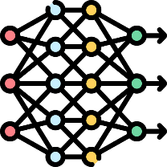



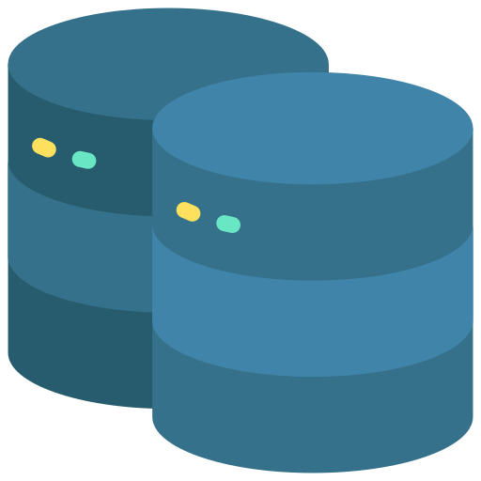
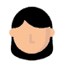
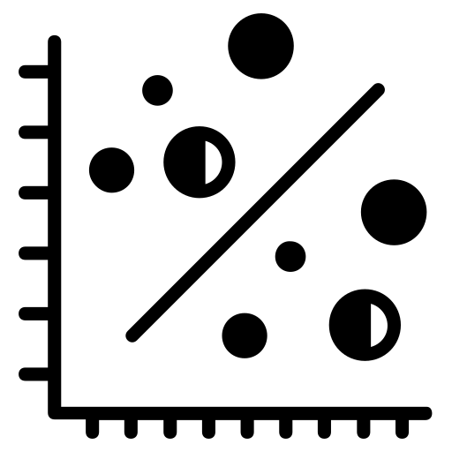
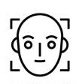





Machine Learning as a Service (MLaaS)
Machine Learning tools as a component of cloud computing.
Flexible and scalable solution.
A critical limitation of the adoption of MLaaS
  low protection of sensitive data in an unsecured shared environment
Open problem: Privacy-preserving ML
Notes:
(Encrypted) Prediction as a service.
Cloud computing has been widely adopted because it allows access to on-demand computing resources.
The user only needs a computer and internet access to be able to use the hardware and software.
El cual se caracteriza por no requerir un manejo directo por parte del usuario.
Cloud providers are continually developing new solutions for different types of industries and necesidades.
A clear example of this is the nascent MLaaS paradigm.
Hace referencia basicamente a una solucióin flexible y escalable para entrenar o desplegar tus modelos de soluciones de ML de manera remota.
These services focus on small companies, developers, and researchers without suitable resources and tools for developing ML solutions.
A critical limitation of the extensive adoption of MLaaS is the low protection of sensitive information. El simple echo de utilizar un servidor en la nube implica cybersecurity problems. Where sensitive information can be released, viewed, stolen, or used by an unauthorized third-party.
Cuando trabajamos con modelos de ML usualmente trabajamos con informacion altamente confidencial y altamente sensible, por lo que requerimos un manejo adecuado en terminos de privacidad de nuestra información.

Slide 31
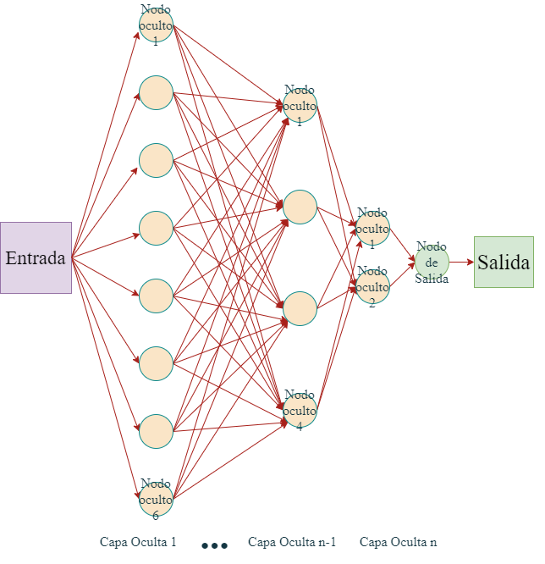

Deep Neural Networks (DNN )
DNN has been used in several disciplines, including
medical image classification
segmentation tasks:
X-ray
MRI
Histopathology
Positron Emission Tomography (PET)
Notes:
\sum_{i=1}^{n}x_{i}*w_{i}

Slide 32
Open challenges in the DNN TRUST:
  Privacy and security issues
  Large volume of images
  Variability in image quality
Notes:
\sum_{i=1}^{n}x_{i}*w_{i}

Slide 33
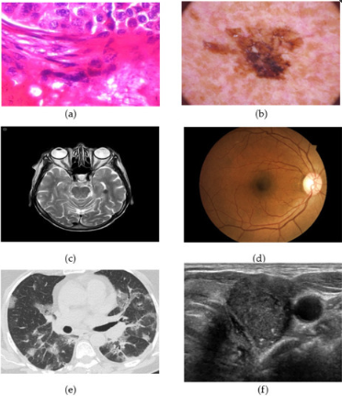
AI for Health Care
Breast cancer
Skin cancer
Brain tumor
COVID-19 screening
Thyroid ultrasound
Alzheimer's disease
etc,

Slide 34
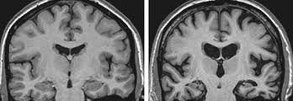
Alzheimer’s Disease (AD)
progressive neurodegenerative disease that affects
  memory, thinking, orientation, and behavior
most common form of dementia worldwide
  10% of older adults (Seniors) in México suffer from it
AD causes gradual morphological changes in a brain
Magnetic Resonance Imaging (MRI)
standard method of AD detection
Sano Alzheimer

Slide 35
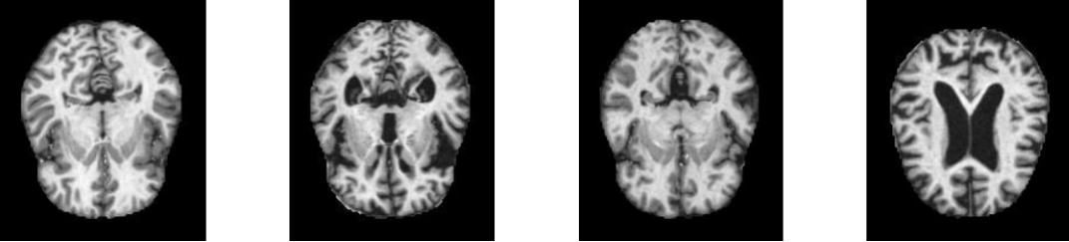
Alzheimer 4 classes
Normal Mild Moderate Severe

Slide 36
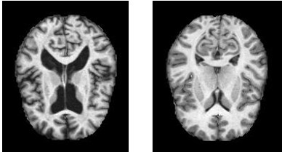
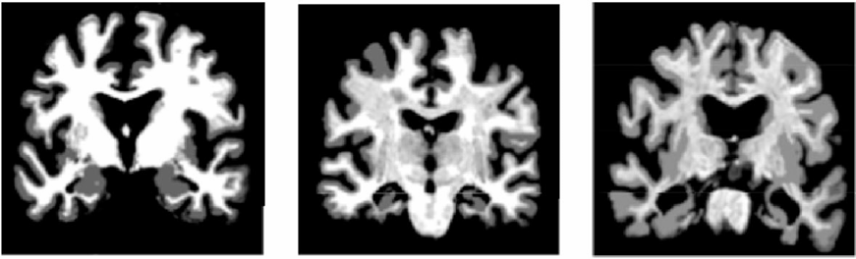
AD classification
Para la clasificación de la EA por IRM existen dos vías
Clasificación Binaria
Clases | Abreviación
Sano | S
Deterioro cognitivo leve | DCL
Alzheimer | EA
No demente | ND
Demente muy leve | DML
Demente leve | DL
Dementes moderados | DM
S EA
Clasificación Multiclase
S DCL EA
ND DML DL DM

Slide 37

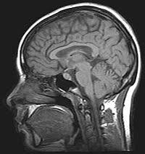
Regulations
Hospitals handle a large volume of data such as:
  Personal data
  Medical Records
  Studies
    Laboratory
    Electrocardiograms
    Image
There are regulations in place to manage this data.
  Sensitive Data
  Patient privacy must be ensured.
  Data anonymization is required
There are challenges in accessing this data:
  Data sharing
  Database creation
  Training computational models
Magnetic Resonance Imaging MRI

Slide 38
Federated Learning
A way to Zero Trust

Slide 39
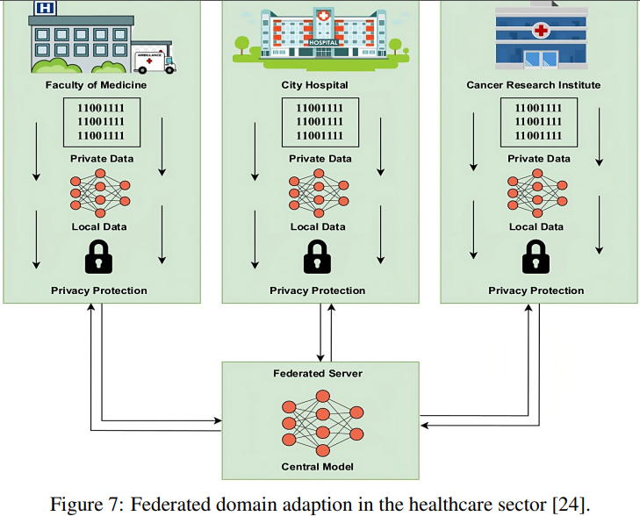
Federated Learning in Health Care

Slide 40

Types of Federated Learning
Horizontal
Vertical
Horizontal: Mismas características, pero diferentes instancias
Vertical: Mismas instancias, pero con características diferentes

Slide 41

Horizontal FL

Slide 42
Federated Learning Models
Federated Learning Type | Data Distribution | Description
Horizontal (HFL) | Same columns, different rows. | Multiple nodes with the same features but different instances.
Vertical (VFL) | Different columns, same rows. | Multiple nodes with different features about the same instances.
Federated Transfer Learning | Different columns and different rows. | Combines FL with transfer learning for heterogeneous data.
Semi-Supervised | Combination of labeled and unlabeled data. | Utilizes labeled and unlabeled data across nodes.
Asynchronous | No synchronization required between nodes. | Allows asynchronous model updates between nodes.
Hybrid | Combination of different columns and rows. | Combines characteristics of HFL and VFL for heterogeneous data.

Slide 43
Homomorphic Encryption
Privacy Preserving Processing
Notes:
Preserving Privacy in Neural Network Processing with Homomorphic Encryption
Privacy-Preserving Neural Networks with Homomorphic Encryption

Slide 44








Privacy Preserving Processing: Cryptography does not help
Caesar cipher
Enigma
44

Slide 45


Homomorphic Encryption foundation
A function applied to ciphertexts provides the same (after decryption) result as applying the function to the original unencrypted data.
Lattice-based schemes whose security is based on the hardness of the Learning with Errors (LWE) or Ring LWE (RLWE) problems.
Homomorphic Encryption (HE) exploits the hardness of identifying a secret 𝒔k from noisy pairs of the form $pk=\left(b, a\right)=\left(\left[−\left(a∙sk+e\right)\right]q, a\right)$
where $sk,a,e∈R_{q}=ℤ_{q}[X]/(X^{n}+1)$,
  $a$ $←U(R_{q_{ }})$ and $e←χ_{err}$.
Encrypt: $\left(m,0\right)+pk=\left(m−a∙sk+e, 0+a\right)=\left(c_{0}, c_{1}\right)=c$ (two polynomials)
Decrypt: $m^{′}=c_{0}+c_{1}∙sk=m−a∙sk+e+a∙sk=m+e≈m$
Notes:
$$\text{HE} \text{is} \text{a} \text{promising} \text{tool} \text{for} \text{security} \text{against} \text{the} \text{quantum} \text{computer} \text{threat}\text{. }\text{RLWE} \text{is} \text{known} \text{to} \text{be} \text{as} \text{hard} \text{as} \text{worst}\text{−}\text{case} \text{lattice} \text{problems}\text{, }\text{which} \text{are} \text{currently} \text{secure} \text{against} \text{attacks} \text{from} \text{quantum} \text{computers}\text{. }$$
$χ_{err}$ denote discrete Gaussian distributions.
Multiplications are done on polynomials, therefore it can be done with a complexity of O(nlog(n)) using Discrete Fourier Transform for polynomial multiplication,
So we said that we have a secret s, and a public key p=(b,a)=(−a.s+e,a). To encrypt a message μ we simply output c=(μ+b,a), and to decrypt it with s we evaluate c0+c1.s which will approximately gives the original message
Decrypt function can be seen as a polynomial evaluation on the secret key $s$.

Slide 46

Homomorphic Encryption foundation
Polynomial ring R= $ℤ[X]$/f(X), where
$ℤ[X]$ - polynomial ring with coefficients in $ℤ$
f(x) is a cyclotomic polynomial of degree d that is the unique irreducible polynomial with integer coefficients that is a divisor of x^{n}−1
In practice, f(x)=X^{d}+1 and d=2^{n}.
Elements of R are polynomials of degree less than d and coefficients in $ℤ$.
q - coefficients modulus
R_{q}[x]= $ℤ_{q}$[x]/f(x)
$ℤ_{q}$[x] - polynomial ring with coefficients modulo q.
R_{q}[x] are polynomials of degree less than d and coefficients modulo q.
[x] rounding to the nearest integer.
χerr and χkey are distributions
Secret key is a polynomial sk <-χ_{key} with binary coefficients randomly sampled from χ_{key}.
Public key pk is a couple of two polynomials $pk=\left(b, a\right)=\left(\left[−\left(a∙sk+e\right)\right]q, a\right)$
Public key is sampled a from the ring R_{q ,} a <- R_{q}, and a random error e from χerr e <- Xerr.
Notes:
$$\text{HE} \text{is} \text{a} \text{promising} \text{tool} \text{for} \text{security} \text{against} \text{the} \text{quantum} \text{computer} \text{threat}\text{. }\text{RLWE} \text{is} \text{known} \text{to} \text{be} \text{as} \text{hard} \text{as} \text{worst}\text{−}\text{case} \text{lattice} \text{problems}\text{, }\text{which} \text{are} \text{currently} \text{secure} \text{against} \text{attacks} \text{from} \text{quantum} \text{computers}\text{. }$$
$χ_{err}$ denote discrete Gaussian distributions.
Multiplications are done on polynomials, therefore it can be done with a complexity of O(nlog(n)) using Discrete Fourier Transform for polynomial multiplication,
So we said that we have a secret s, and a public key p=(b,a)=(−a.s+e,a). To encrypt a message μ we simply output c=(μ+b,a), and to decrypt it with s we evaluate c0+c1.s which will approximately gives the original message
Decrypt function can be seen as a polynomial evaluation on the secret key $s$.

Slide 47
HE taxonomy
By supported arithmetic operations
By type of data
Partially homomorphic Encryption (PHE):
Supports only addition or multiplication.
Somewhat Homomorphic Encryption (SWHE):
Bounded additions and multiplications
Computationally cheap.
No bootstrapping
Pre-2009 schemes were somewhat homomorphic.
Fully Homomorphic Encryption (FHE)
Unbounded additions and multiplications
Computationally expensive
Bootstrapping notion
  Logical (Boolean)
      FHEW
      TFHE
  Integer based
      Brakerski-Gentry-Vaikuntanathan (BGV)
      Brakerski/Fan-Vercauteren (BFV)
      Lopez-Tromer-Vaikuntanathan (LTV)
      Doroz-Hu-Sunar (DHS)
  Fixed-precision numbers
      Cheon-Kim-Kim-Song (CKKS)
Notes:
theoretical speculations to actual solutions, where several companies, such as IBM [26], are now offering HE services
IBM security homomorphic encryption services: https://www.ibm.com/security

Slide 48
General-purpose HE libraries
Tool | Support | Pros | Cons
SEAL | Microsoft | Well-documented Easy security parameters setting | Poor flexibility Limited number of supported schemes
HElib | IBM | Efficient homomorphic operations | Low bootstrapping performance Complicated security parameter setting
TFHE |  | Fast bootstrapping | Poor performance for simple tasks
PALISADE OpenFHE | DARPA, MIT, UCSD, etc. | Multiple HE schemes Cross-platform | Poor documentation and support
cuHE |  | Mass parallelism and high memory bandwidth of GPUs
HEAAN | Seoul National University | Operations between rational numbers
HE-transformer | Intel | Integration with deep learning libraries | Extension of SEAL

Slide 49

















Homomorphic Neural Network
Approximating an activation function
$$\ddot{f_{k}}=a_{0}^{k}+a_{1}^{k}x+a_{2}^{k}x^{2}+…+a_{n}^{k}x^{n}$$
$$\ddot{+}$$
$$\ddot{+}$$
$$\ddot{+}$$
$$\ddot{+}$$
$${\overline{x}}_{1}$$
$${\overline{w}}_{1}$$
$$Σ$$
$${\overline{w}}_{2}$$
f ()
$${\overline{x}}_{2}$$
$$\overline{y}$$
ReLU
...
$${\overline{w}}_{i}$$
$${\overline{x}}_{i}$$
Weighted sum.
$\overline{y}$= ${\overline{w}}_{1} {\overline{x}}_{1}$ ${\overline{w}}_{2}$ ${\overline{x}}_{2}$ ${\overline{w}}_{i}$ ${\overline{x}}_{i}$
...
$$\ddot{+}$$
$$\ddot{+}$$
$$\ddot{+}$$
Notes:
Su objetivo principal es introducir no linealidad en la red, lo que permite a la red aprender y modelar relaciones complejas en los datos de entrada.
Sin funciones de activación no lineales, la red neuronal sería esencialmente solo una combinación lineal de capas, lo que limitaría su capacidad para modelar patrones complejos en los datos.
Las funciones de activación no lineales permiten a la red aprender relaciones no lineales entre las características de entrada y las salidas deseadas. Esto es fundamental para que la red pueda capturar y representar patrones en los datos que no son lineales.

Slide 50




Aproximating $sign$ (time)
Homomorphic operations:
Timings (ms) for the four processes in a HE scheme
Operations:
Addition: 0.087 ms, HE 11.7310 ms
Multiplication: 0.099 ms, HE 30.2540
Comparison: 0.0464 milliseconds, HE 143.28 ms
HE comparison needs to be optimized; otherwise, it is inapplicable.
Performance (ms) of state-of-the-art homomorphic comparison approaches
Slight improvements of homomorphic comparison are high steps toward a privacy-preserving model
Notes:
We study the performance of several approaches for approximate by polynomials the sign function, including the Composition of polynomials.
In this table and figure, we can see the polynomial approximation itself and the generation and evaluation time of each method.
Why is it so important to reduce a few milliseconds? The ratio between the best and the worst homomorphic comparison approach could be very small. However, modern networks contain hundreds, or millions of neurons, where each neuron computes a comparison operation, i.e., an activation function.
So, if you reduce the comparison operation in 1 millisecond, you can optimize a network with a million neurons in a million milliseconds.
The homomorphic comparison needs to be optimized. An homomorphic comparison takes around 2000 times more than a non-homomorphic comparison. Therefore, slight improvements of homomorphic comparison are high steps toward a privacy-preserving model.

Slide 51
Self-Learning Activation Functions
Notes:
We propose approximating the activation function by assuming a functional form at each neuron with learnable parameters updated during training.

Slide 52






Self-Learning Activation Functions (SLAF)
We approximate the activation function by a polynomial at each neuron independently with trainable coefficients as
$${\overline{y}}_{k}←{\ddot{f}}_{k}\left(\sum^{ _{ }}{\left({\overline{w}}_{i}^{k}\ddot{×}c_{i}^{k}\right) \ddot{+} {\overline{β}}_{k}}\right)$$
$$\ddot{f_{k}}=a_{0}^{k}+a_{1}^{k}x+a_{2}^{k}x^{2}+…+a_{n}^{k}x^{n}$$
where $a_{0}^{k}, a_{1}^{k}, …, a_{n}^{k}$ denote the trainable coefficients of the polynomial $\ddot{f_{k}}$ at neuron $k$.
Activation function approximation is optimized for a given problem and dataset.
Training process aims to find:
  Weights $w$
  Coefficients $a_{0}^{k}, a_{1}^{k}, …, a_{n}^{k}$
Homomorphic neuron $k$ with a SLAF ${\ddot{f}}_{k}$
Notes:
The idea behind a trainable activation is to search for an adequate function shape using knowledge given by the training data
Ideally, NN should be able to incorporate the variability that arises in a learning problem due to task type and data properties through adaptation. The same should be true for activation.
A NN is a computing model system that mimics the behavior of a biological brain. It attempts to learn underlying relationships in the information provided by a dataset.
Main concepts in the learning process:
Synapses. More neuronal connections $→$ Better learning process
Plasticity. Physiological capacity that allows the brain to adapt to new ways of learning

Slide 53

Federated Learning privacy preserving

Slide 54
Thanks for the team

Slide 55


















Team
CICESE Parallel Computing Laboratory
55

Slide 56
and collaborators

Slide 57












Collaboration
Tec. de Monterrey
Universidad Estatal de Sonora (UES)
Cinvestav
Mexico
USA
France
Russia
Germany
Luxembourg
Uruguay
Spain
China
Colombia
Argentina
Dortmund University
Prof. Uwe Schwiegelshohn
University of Göttingen
Prof. Ramin Yahyapour
University of Notre Dame Dr. Jarek Nabrzyski
University of California – Irvine, CA, USA
Prof. Isaac Scherson,
Prof. Jean Luc Gaudiot
University of Luxembourg
Prof. Pascal Bouvry
Prof. Franck Leprevost
Universidad de la República
Dr. Sergio Nesmachnow
Institute for System Programming
Prof. Arutyun Avetisyan
Moscow Institute of Physics and Technology - Prof. Alexander Drozdov
Institute of Applied Mathematical Research, Petrozavodsk
Dr. Evgeny Ivashko, Dr. Natalia Nikitina
North-Caucasus Federal University, Stavropol - Dr. Mikhail Babenko
South Ural State University
Dr. Gleb Radchenko,
Institute for System Dynamics and Control Theory of SB RAS, Irkutsk
Alexander Feoktistov, Igor Bychkov
Los Andes University
Dr. Harold Castro
Universidad Industrial de Santander
Dr. Carlos BARRIOS
Tsinghua University
Dr. Zhihui Du
IMAG
Prof. Denis Trystram
INRIA Lille - Nord Europe
Prof. El-ghazali Talbi
BSC - Prof. Vassil Alexandrov
Buenos Aires University
Esteban Mocskos

Slide 58



Thanks for your attention!
Ensenada
Ensenada
Redmer Hoekstra

Slide 59

Thanks for your attention!

