Slide 1
Next Generation WiFi
Leading the Wi-Fi Revolution
May 2025

Slide 2
Agenda
Overview
Spectrum vs Standard
The RUCKUs Advantage

Slide 3
Overview

Slide 4
After 25 years, Wi-Fi is still evolving rapidly
Notes:
The Wi-Fi landscape is rapidly evolving
Connectivity especially using Wi-Fi is becoming a basic human need
Wi-Fi is coming to more places, it is no longer just a coffee-shop amenity
Growing # of use cases and deployments never imagined before
Major innovations in the unlicensed spectrum with pivotal shift towards faster and better Wi-Fi standards
Transition: But one thing has not changed since Wi-Fi first became available in the 5 GHz band. The amount of available spectrum.

Slide 5
Evolving from speed to capacity and predictability
Wi-Fi®
First Gen
Wi-Fi
Next Gen
The first 10 billion devices
The next 20 billion devices
Peak data rates, aggregate throughput
Network efficiency and capacity
Under ideal conditions
Under real-world conditions
Improve average & worst-case performance
Wi-Fi 4
Wi-Fi 5
Wi-Fi 6 / Wi-Fi 6E
Wi-Fi 7
802.11a/b
802.11g
802.11n
11ac MU-MIMO
802.11ax
6 GHz
802.11be
802.11ac
1999
2003
2008
2013
2019
2021
2023
High Throughput
(HT) Standard
Very High Throughput
(VHT) Standard
High Efficiency
(HE) Standard
Extremely High
Throughput
(EHT) Standard
Notes:
6 GHz Wi-Fi adoption will grow stronger in 2023 and beyond
Automated Frequency Coordination (AFC) certification anticipated 1H 2023
Growing number of countries outside of U.S., EU adopting the spectrum for unlicensed use
Adoption in the home before 2023 around 6E.
Wi-Fi 7 is where 6 GHz volume will pick up
Wi-Fi 6E will transition quickly to Wi-Fi 7
RUCKUS 6 GHz outdoor APs will follow AFC timing
Entire RUCKUS portfolio will transition to 6 GHz in the Wi-F 7 timeframe

Slide 6
Wi-Fi 7 Ecosystem Projected Timeline
Mobile Phone Launch
Q4 2022 / Q1 2023
(Xiaomi, Vivo, OnePlus, Oppo …)
Windows Laptop Launch
(Acer, MSI)
PC Motherboard Launch
(MSI, ASRock)
PC Motherboard Launch
(Asus, Gigabyte)
Wi-Fi 7 Clients
2023
2024
Wi-Fi 7 APs
Consumer AP Launch
Q4 2022 / Q1 2023
(TP-Link, Asus,
CommScope ARRIS, Xiaomi, Netgear …)
Initial Enterprise AP Launches
2H 2023
More Enterprise AP Launches
2024
Wi-Fi Alliance Wi-Fi 7 Certification

Slide 7
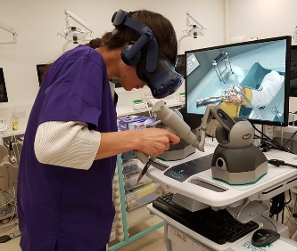
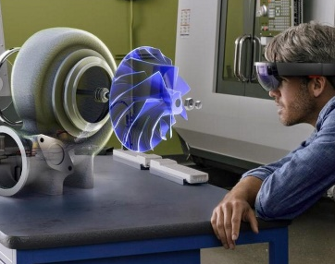
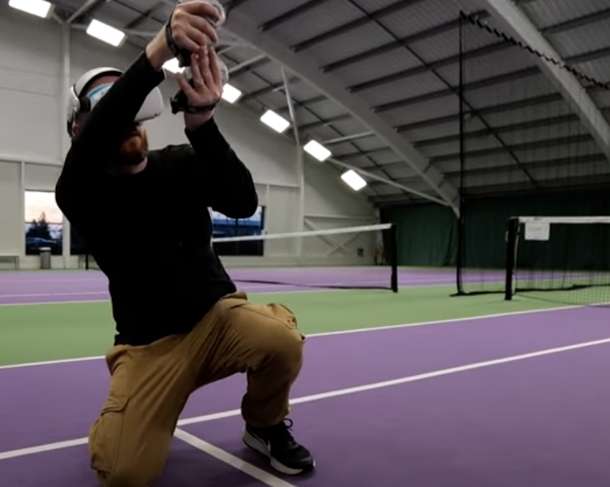
New use cases and requirements
Remote Research
Collaborative 3D design
Extended reality (AR/VR)
Post pandemic Video Conferencing explosion
Social Gaming & e-Sports
8K Streaming
IoT/Operational Technology
Low latency, affected by:
Distance
Speed
Media Contention
High Reliability
High speed
Arena gaming
Operational Technology - IoT
Operational Technology - Manufacturing

Slide 8
Spectrum vs Standard

Slide 9
Wi-Fi 6
Attribute | Wi-Fi 6
Specification Status | September 2020
Freq Bands supported | 2.4, 5 GHz
Maximum Spatial Streams | 8x8
Highest Modulation | 1024 QAM
Maximum Channel Width | 160 MHz
Max PHY Rate | 9.6 Gbps
Notes:
Setting the baseline that most people are familiar with.

Slide 10
Wi-Fi 6 vs. Wi-Fi 6E
Attribute | Wi-Fi 6 | Wi-Fi 6E
Specification Status | September 2020 | January 2021
Freq Bands supported | 2.4, 5 GHz | 6 GHz
Maximum Spatial Streams | 8x8 | 8x8
Highest Modulation | 1024 QAM | 1024 QAM
Maximum Channel Width | 160 MHz | 160 MHz
Max PHY Rate | 9.6 Gbps | 9.6 Gbps
Notes:
The purpose here is to show that Wi-Fi 6E simply extends the 11ax protocol and specs into the 6 GHz band, without adding any new specs and features.

Slide 11
Wi-Fi 6 vs. Wi-Fi 6E vs. Wi-Fi 7 Comparison
Attribute | Wi-Fi 6 | Wi-Fi 6E | Wi-Fi 7
Specification Status | September 2020 | January 2021 | Draft 2.0 (May 2022)
Freq Bands supported | 2.4, 5 GHz | 6 GHz | 2.4, 5, 6 GHz
Maximum Spatial Streams | 8x8 | 8x8 | 16x16
Highest Modulation | 1024 QAM | 1024 QAM | 4096 QAM
Maximum Channel Width | 160 MHz | 160 MHz | 320 MHz
Max PHY Rate | 9.6 Gbps | 9.6 Gbps | 46.1 Gbps
Notes:
This slide introduces Wi-Fi 7 showing the first protocol released that supports all three bands.
Animation shows the split in bands, while showing the specs the same.

Slide 12
Wi-Fi 6 vs. Wi-Fi 6E vs. Wi-Fi 7 Comparison
Attribute | Wi-Fi 6 | Wi-Fi 6E | Wi-Fi 7
Specification Status | September 2020 | January 2021 | Draft 2.0 (May 2022)
Freq Bands supported | 2.4, 5 GHz | 6 GHz | 2.4, 5, 6 GHz
Maximum Spatial Streams | 8x8 | 8x8 | 16x16
Highest Modulation | 1024 QAM | 1024 QAM | 4096 QAM
Maximum Channel Width | 160 MHz | 160 MHz | 320 MHz
Max PHY Rate | 9.6 Gbps | 9.6 Gbps | 46.1 Gbps
Notes:
This slide is an animation of sliding those two different highlights over to Wi-Fi 7 to show why Wi-Fi 7 is such a big advancement.
All three bands, upgraded specs.

Slide 13
Is the migration to WiFi 7 necessary today?

Slide 14
Quick answer:
It depends
Consider implementation of hybrid technologies
Wait until we have more WiFi 7 devices available
Consider doing an upgrade of your cabling and switching infrastructure first
Notes:
Purpose of this slide is to introduce the Why of the 8200 line of switches.
The 8200 is purpose built for 6 GHz and Wi-Fi 7, and meets all the specs required to support these new networks.

Slide 15
RUCKUS is ready to deploy a complete WiFi 7 infrastructure today

Slide 16
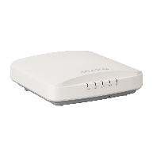
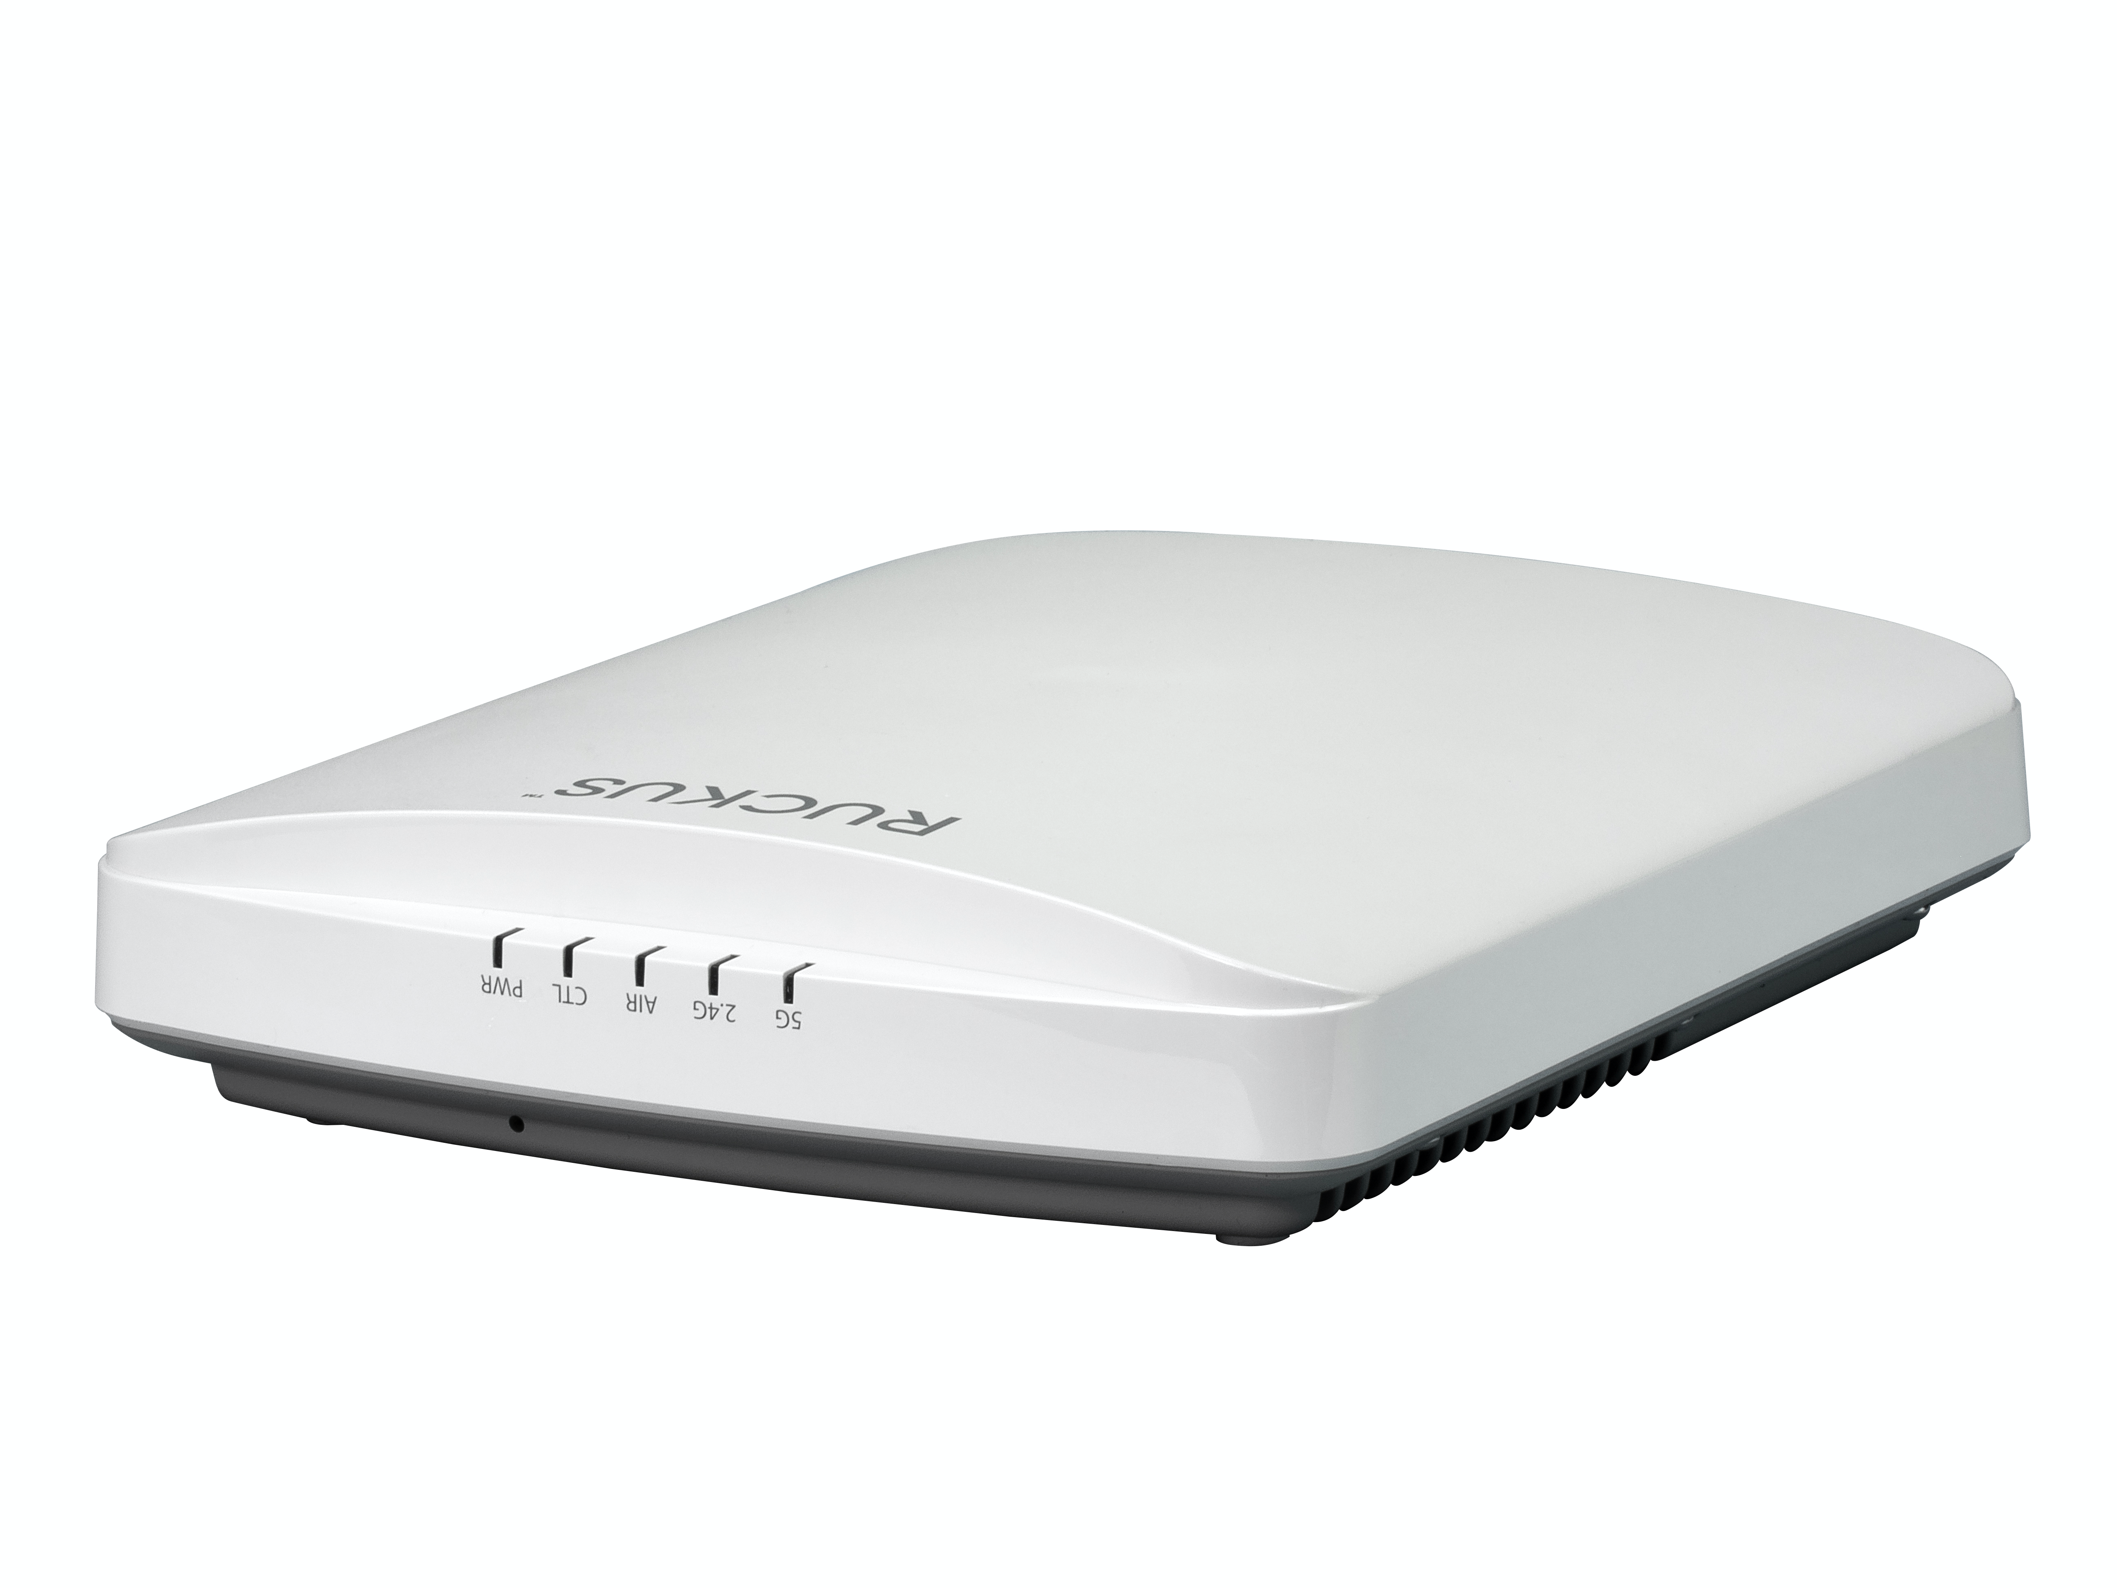
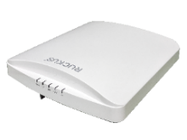
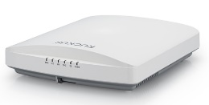
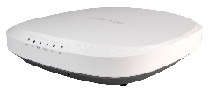
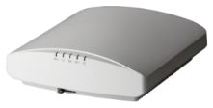
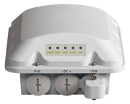
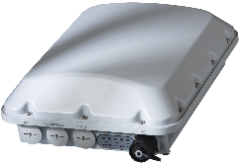
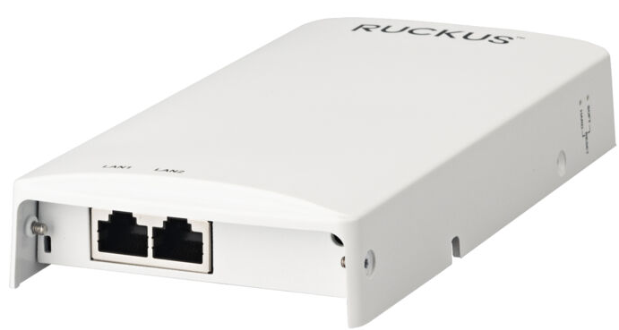
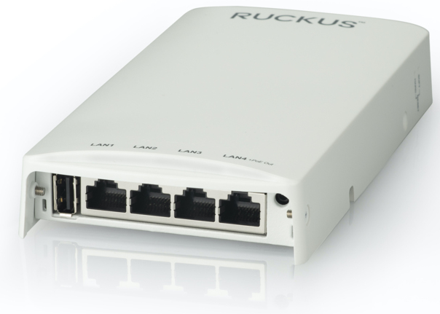
RUCKUS Wi-Fi 6/6E AP Portfolio
 | Good | Better | Best
Indoor
Outdoor
Specialty
Tri-Band 6GHz
Tri-Band 6GHz
R350
Wi-Fi 6
2x2:2
R550 Wi-Fi 6
2x2:2
R560 Wi-Fi 6E
2x2:2 5GbE
R650 Wi-Fi 6
4x4:4/2x2:2
R750
Wi-Fi 6
4x4:4 | 2.5GbE
R850
Wi-Fi 6
8x8:8 | 5GbE
R760
Wi-Fi 6E
4x4:4 | 10GbE
IoT Ready
IoT Onboard
IoT Onboard
IoT Onboard
IoT Onboard
IoT Onboard
IoT Onboard
1.8 Gbps
1.8 Gbps
4.7 Gbps
2.5 Gbps
3.5 Gbps
5.9 Gbps
8.35 Gbps
T350/350se Wi-Fi 6
2x2:2
T750/T750se
Wi-Fi 6
4x4:4 | 2.5GbE
IoT Onboard
IoT Onboard
H350 Wi-Fi 6
2x2:2, 2 Port Switch
H550 Wi-Fi 6
2x2:2, 4 Port Switch
IoT Onboard
IoT Onboard Dual Concurrent

Slide 17
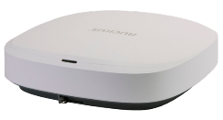
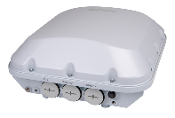
RUCKUS Wi-Fi 7 AP Portfolio
 | Good | Better | Best
Indoor
Outdoor
Specialty
Tri-Band 6GHz
Tri-Band 6GHz
Introduced
On Q4’23
R670 Wi-Fi 7
2x2:2 5GbE
Q3’24
R770
Wi-Fi 7|10GbE
2X2/4x4/2x2
IoT Onboard
IoT Onboard
9.34 Gbps
12.22 Gbps
Tri-Band 6GHz
T670
Wi-Fi 7
2x2:2 | 5GbE
Q3’24
9.34 Gbps

Slide 18
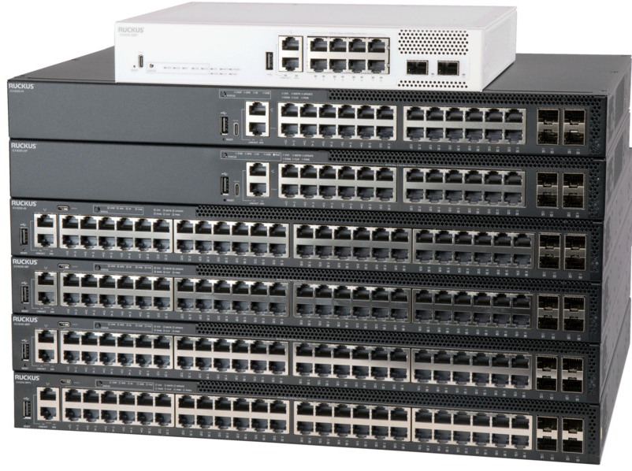
ICX 8200 Switch – Designed for 6 GHz
Maximum flexibility and connectivity options: Gigabit, Multigigabit edge ports and Fiber to the Room, optimized for latest generation Wi-Fi 6/6E/7 AP deployments with multigigabit ports. 1/2.5/5/10 Gbps Copper ports, 1G SFP and 10G SFP+ fiber ports
Power next generation APs and PoE devices: PoE+ 802.3at, 30W per port on all ports. PoE++ 802.3bt, 60/90W on multigigabit ports and up to 1480W PoE budget with two power supplies
25 GbE uplinks/stacking offers maximum performance and future-proofing: Up to 8x 1/10/25GbE SFP28 fiber ports for uplink and/or stacking
Advanced L3 routing for flexibility: IPv4 and IPv6 L3 routing.
Static routes; RIP, OSPF, VRRP, VRF, GRE, PIM, PBR
Enhanced availability: Redundant, load-sharing hot-swap
power supplies and fans on specific models
Services and Support Included: 3 years of remote TAC support
included with every ICX 8200 model and Limited lifetime warranty ​​​​​​​​​​​​​
Enhanced Security and data privacy: VXLAN* support
for advanced network segmentation and data confidentiality
Notes:
Purpose of this slide is to introduce the Why of the 8200 line of switches.
The 8200 is purpose built for 6 GHz and Wi-Fi 7, and meets all the specs required to support these new networks.

Slide 19
RUCKUS Technology Vision
Be innovative and deliver the right technology for the job while securely connecting business applications
Customer Business Applications / Processes
AI/ML-driven Cloud Management and Assurance
Policy, Control & Data Steering
Wired
Wi-Fi
Bluetooth
Zig-Bee
Z-WAVE
Sensors, Cameras, and Data Collection Devices
Notes:
Let’s establish one thing at this point - network services exist to meet business application needs!
Hence, we are innovating.
We are innovating to deliver an access-network-neutral platform such that an enterprise does not have to worry about how to satisfy needs of those applications.
We are simplifying it for our customers.
Our vision is to offer just the right network solution for any given use case by delivering just the right bandwidth, security, reliability, and coverage as warranted by that particular use case by deploying one or more of these underlying network technologies – wired, Wi-Fi 7, 5G, CBRS, and IoT depending on customers’ needs.
FROM JOSH: And THIS is what we mean when we say “purpose-driven” … it’s about innovating and delivering the RIGHT TECHNOLOGY FOR THE JOB … the one that’s going to deliver the most exceptional connectivity experience possible.
We are working towards a network design that delivers best-in class radio performances while offering powerful security framework and easy to use management software.
Security and policy control engine provides a robust policy framework to deliver amazing device/user experience securely.
AI/ML-driven simple yet unified management and analytics framework for configuration, orchestration, management, assurance, and troubleshooting.
Granular slice management and QoS based on
Application
User
Device
Department, Location, Time
So if I were to show you in this pictorial view of an application stack,
CLICK
Everything within that orange box is what we aim to deliver.
FROM JOSH: And

Slide 20
Innovation with a purpose
THANK YOU!
© 2023 CommScope, Inc. All rights reserved. CommScope and the CommScope logo are registered trademarks of CommScope and/or its affiliates in the U.S. and other countries. For additional trademark information see https://www.commscope.com/trademarks Wi-Fi, Wi-Fi 4, Wi-Fi 5, Wi-Fi 6, Wi-Fi 6E and Wi-Fi 7 are trademarks of the Wi-Fi Alliance. [Note: additional TM notices may be needed for the Wi-Fi Certification marks]. Bluetooth is a trademarks of Bluetooth SIG, Inc. Zigbee and Matter are trademarks of the Connectivity Standards Alliance. Thread is a trademark of the Thread Group, Inc. All other product names, trademarks and registered trademarks are property of their respective owners.

